Slide 1



Machine Learning Based Routing Congestion Prediction in FPGA High-Level Synthesis
Jieru Zhao¹, Tingyuan Liang¹, Sharad Sinha², Wei Zhang¹
¹Hong Kong University of Science and Technology (HKUST)
²Indian Institute of Technology Goa (IIT Goa)
IIT GOA
INDIAN INSTITUTE OF TECHNOLOGY GOA

Slide 2
Outline
Background
Machine-Learning Based Methodology
Experimental Results
Conclusion

Slide 3
Outline
Background
Machine-Learning Based Methodology
Experimental Results
Conclusion

Slide 4

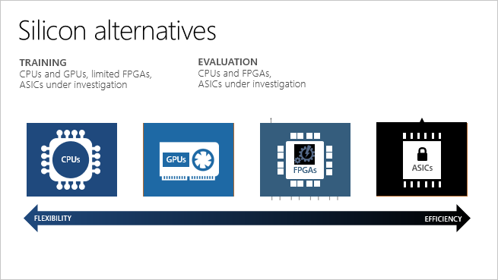

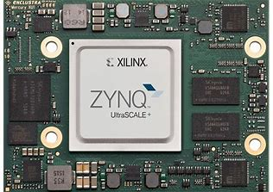
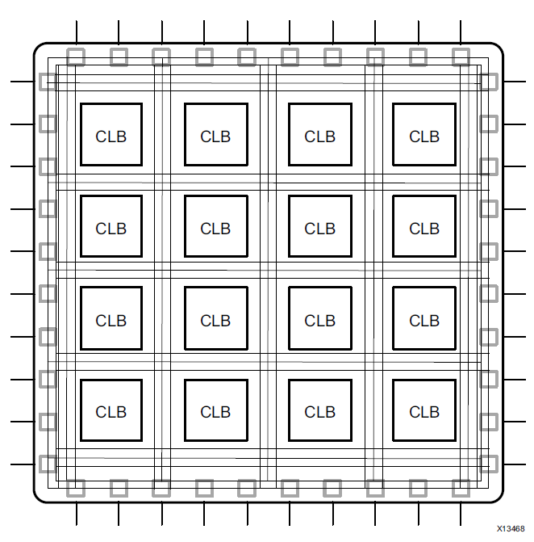


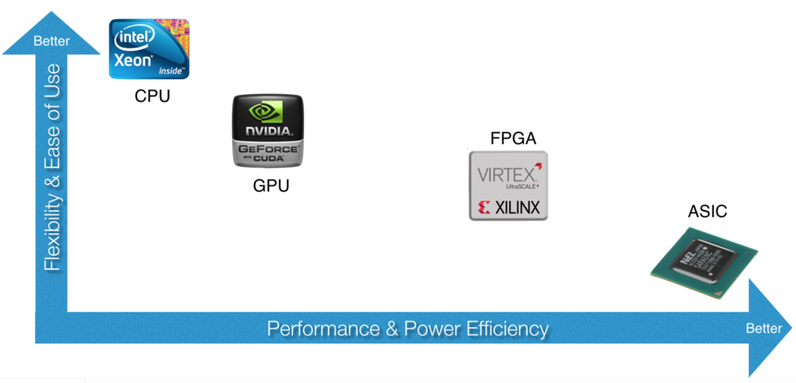

Background: FPGA
Basic FPGA Architecture:
LUT
Flip-flop
DSP Block
Storage elements: BRAM
As an accelerator, FPGA has:
High performance
Low power
Programmability & Flexibility
Short time-to-market
A wide range of applications:
Data center
Image processing
Communications
…

Slide 5

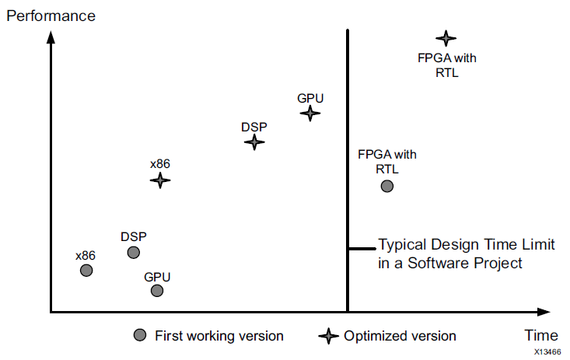


FPGA CAD design flow
C/C++
Frontend Compilation
IR
Scheduling
Hardware Binding
Code Generation
HDL
RTL Implementation Flow
Logic Synthesis
High performance.
Technology Mapping
High development cost.
Netlist
Error-prone and time-consuming.
Place and Route (PAR)
Hard to debug.
BitStream
[Source from Xilinx]

Slide 6
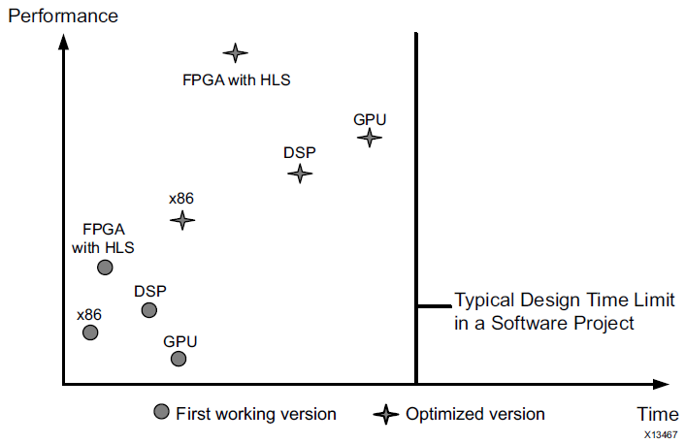
FPGA CAD design flow
C/C++
High-Level Synthesis Flow
Frontend Compilation
Easier to implement.
IR
Fast design space exploration.
Scheduling
Hardware Binding
Hard to grasp hardware implementation details.
Code Generation
HDL
RTL Implementation Flow
Logic Synthesis
High performance.
Technology Mapping
High development cost.
Netlist
Error-prone and time-consuming.
Place and Route (PAR)
Hard to debug.
BitStream
[Source from Xilinx]

Slide 7
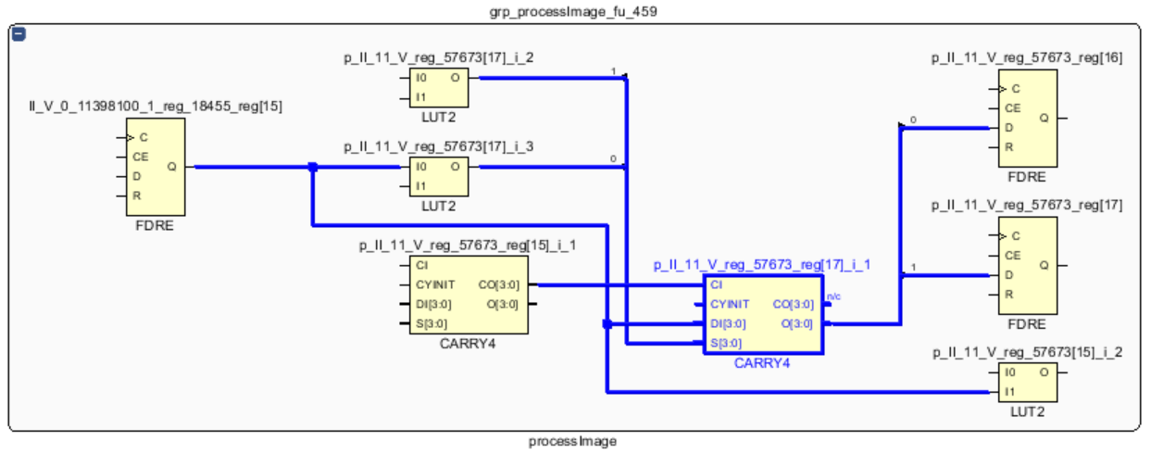
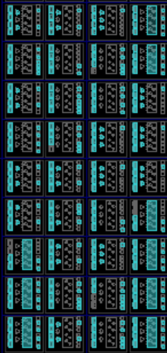
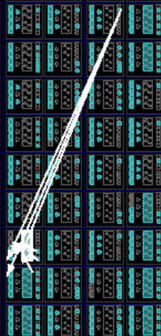
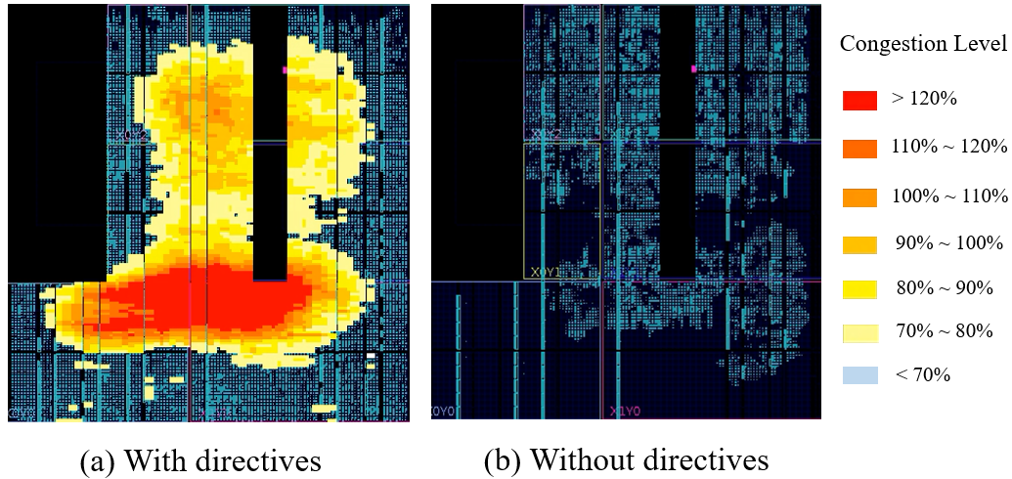
Issue: Routing Congestion
HDL
Logic Synthesis
Technology Mapping
Netlist
Place and Route (PAR)
BitStream
Netlist
Placement
Routing
In FPGA design, routing contributes a lot to delay and resource utilization.
Congested region
Longer delays
More routing resources
Degrade performance
Implementation failures
Wires are detoured

Slide 8

How to solve this issue?
Physical design: Routability driven placement.
Time-consuming: invoke the router repeatedly.
Congestion prediction model guides the placement.
Machine learning techniques.
Features: #bounding boxes, half-perimeter wirelength (HPWL), #pins …
When the abstraction level increases…
Beneficial: easier to resolve congestion at C source-code level.
Time-consuming: run the C-to-bitstream flow.
Congestion prediction is required.
Question: How to predict routing congestion in HLS?

Slide 9
Challenges
GUI-based “back to verilog” for each CLB after PAR.
Not applicable to build a dataset containing a large number of samples.
We need “back to C”.
Automate the process: congestion metrics per CLB -> operations in C code.
Lack of physical metrics or features at a higher level of abstraction.
Physical features obtained during placement: #bounding boxes, HPWL, #pins …
Extract new informative features in HLS.
Choice of machine learning models.
Linear, ANN, Decision tree…
Explore different kinds of machine learning models.

Slide 10
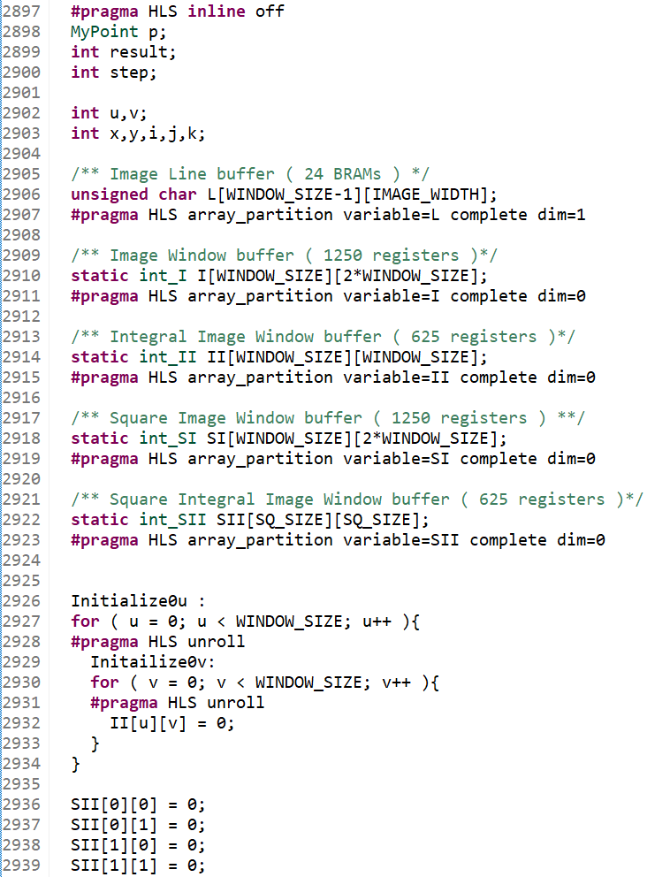
Motivational Example
For HLS-based designs,
Applications are implemented with C/C++.
Hardware-friendly C code.
Synthesis directives are applied to configure the design.
Loop unrolling
Loop pipelining
Array partitioning
Function inlining
…
Careful selection of directives.

Slide 11



Motivational Example
Implementation | WNS (ns) | Max Freq. (MHz) | Latency (cycles) | Max Congestion (%)
With directives | -13.643 | 42.3 | 1.08 × 10⁶ | 178.96
Without directives | -0.066 | 99.3 | 1.73 × 10⁷ | 58.51
Application: Face Detection.
By applying several directives as shown in the application code:
Latency (cycles)
Congestion
Max frequency
Note: WNS denotes the worst negative slack.
Time cost:
Logic synthesis and PAR: nearly 7 hours.
HLS: several minutes.
By early detection, we can avoid non-friendly coding style and improper directives!
Routing Congestion Maps.

Slide 12
Our Contributions
To the best of our knowledge, we are the first to build a routing congestion prediction model in FPGA HLS.
We develop an automatic tool to back trace the congestion metrics of CLBs and link with the HLS IR.
We propose seven informative categories of features and compare three machine learning models.
We propose effective solutions to resolve routing congestion.

Slide 13
Outline
Background
Machine-Learning Based Methodology
Experimental Results
Conclusion

Slide 14
Overview of our approach
C/C++
Information Collection
Training Phase
Construct the dataset for training.
Back tracing
Information collection
Feature extraction
Model training
Prediction Phase
Congestion prediction
Congestion resolving
High Level Synthesis Flow
IR
Feature
Extraction
HDL
Back Tracing
Dataset
RTL Implementation Flow
Model Training
Model Training
Congestion
metrics
High Level Synthesis Flow
Features
Models
Design
Congestion
Prediction
Modified Design
Congestion Resolving
Congested
Region
Optimized Design

Slide 15
1. Automatic Back Tracing
C/C++
Source Code
for ( u = 0; u < window_size; u++)
#pragma HLS unroll
for ( v = 0; v < window_size; v++ )
#pragma HLS unroll
II[u][v] = II[u][v] + ( I[u][v+1] - I[u][0] );
High-Level Synthesis Flow
C statements in the source code.
Frontend Compilation
IR
Intermediate Representation (IR)
id=“1858”:
%II_V_5_10_1 = phi i18 [ 0, %... ], [ %p_II_135_V, %...]
……
id=“3373”:
%tmp_35_5_s = sext i14 %r_V_4_5_s to i18
id=“3374”:
%p_II_135_V = add i18 %tmp_35_5_s, %II_V_5_1
Scheduling
IR operations in LLVM IR.
Hardware Binding
Code Generation
HDL Description
assign p_II_135_V_fu =
($signed(tmp_35_5_s_fu) + $signed(II_V_5_10_1_reg));
……
assign p_II_112_V_fu =
($signed(tmp_35_4_11_fu) + $signed(II_V_4_12_1_reg));
RTL operations in HDL description.
HDL
RTL Implementation Flow
Logic Synthesis
Technology Mapping
CLB, Net of the output Pin
CLBLM_R_X69Y98, p_II_112_V_reg_58246[7]_i_7_n_4
CLBLM_R_X69Y52, SI_V_24_35_1_reg_30030_reg_r_
…….
Net of the output pin for each CLB.
Netlist
Place and Route (PAR)
Congestion metrics and corresponding CLB coordinates.
CLB, Row, Column, Vertical Cong(%), Horizontal Cong(%)
CLBLM_R_X71Y149, 7, 129, 36.02, 48.33
CLBLM_R_X69Y52, 101, 172, 87.05, 39.04
…….
Congestion metrics

Slide 16
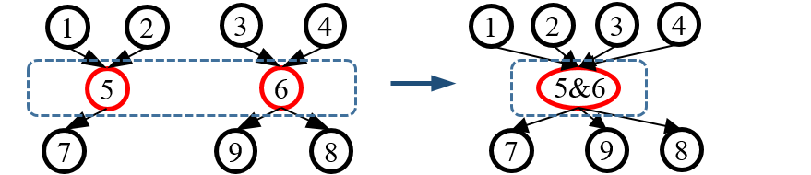
2. Information Collection
Each sample in the dataset contains:
Features of each operation.
Labels: corresponding congestion metrics.
To extract features, a graph is constructed to store the HLS-based information.
Node: HLS IR operations.
Node attributes: resource usage, bitwidth, delay…
Edge: dependency among operations.
Edge weight: the number of wires for the corresponding connection.
When constructing the graph, we also consider…
a
b
1
c
1
2
2
3
3
d
Resource sharing: merge the nodes that share the RTL module.
Function Interface: add I/O port in the graph.

Slide 17
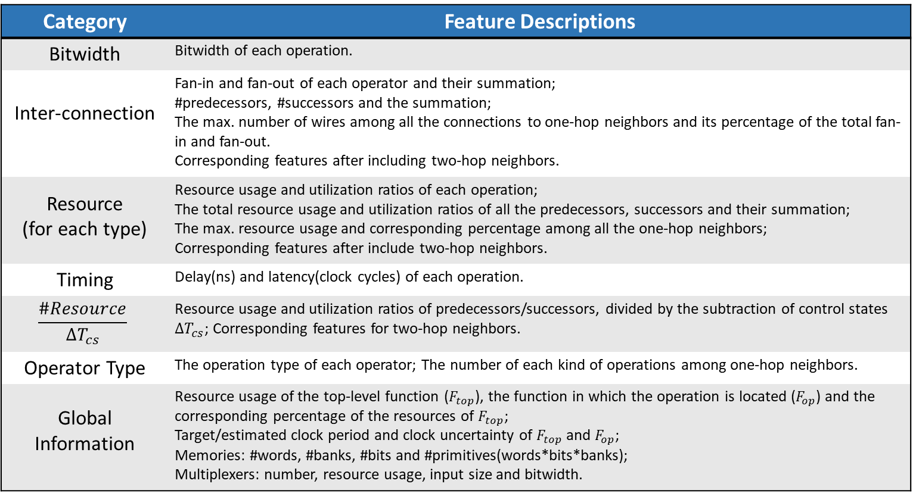
3. Features
Category | Feature Descriptions
Bitwidth | Bitwidth of each operation.
Inter-connection | Fan-in and fan-out of each operator and their summation; #predecessors, #successors and the summation; The max. number of wires among all the connections to one-hop neighbors and its percentage of the total fan-in and fan-out. Corresponding features after including two-hop neighbors.
Resource (for each type) | Resource usage and utilization ratios of each operation; The total resource usage and utilization ratios of all the predecessors, successors and their summation; The max. resource usage and corresponding percentage among all the one-hop neighbors; Corresponding features after include two-hop neighbors.
Timing | Delay(ns) and latency(clock cycles) of each operation.
$$\frac{\#Resource}{∆T_{cs}}$$ | Resource usage and utilization ratios of predecessors/successors, divided by the subtraction of control states $∆T_{cs}$; Corresponding features for two-hop neighbors.
Operator Type | The operation type of each operator; The number of each kind of operations among one-hop neighbors.
Global Information | Resource usage of the top-level function ($F_{top}$), the function in which the operation is located ($F_{op}$) and the corresponding percentage of the resources of $F_{top}$; Target/estimated clock period and clock uncertainty of $F_{top}$ and $F_{op}$; Memories: #words, #banks, #bits and #primitives(words*bits*banks); Multiplexers: number, resource usage, input size and bitwidth.
Notes:
Brief introduction

Slide 18
3. Features
In summary, for each operator, we consider:
Features of the operator itself.
Bitwidth, fan-in, fan-out, timing-related features, resource usage…
Features that reflect the global information.
Total resource usage of the functions, target/estimated clock period, #mux…
Features that reflect the impact of neighboring operators.
One-hop neighbors.
Two-hop neighbors.
Notes:
Summarize

Slide 19

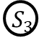
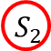
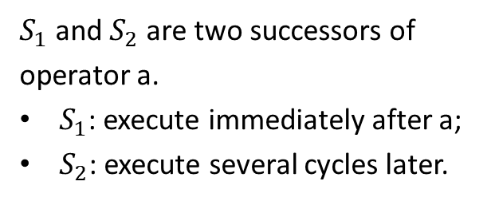
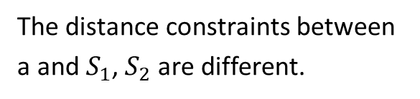
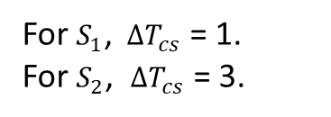
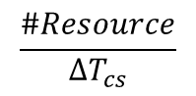
3. Features
Neighboring operators:
Features that reflect the impact of neighbors:
Inter-connections
Resource usage
Spatial distance
2
2
2
2
$$\frac{\#Resource}{∆T_{cs}}$$
1
1
1
1
2
0
2
0
$S_{1}$ and $S_{2}$ are two successors of operator a.
$S_{1}$: execute immediately after a;
$S_{2}$: execute several cycles later.
1
1
1
1
C=1
a
4
2
2
4
2
2
C=2
$$S_{1}$$
3
3
C=3
$$S_{3}$$
The distance constraints between a and$S_{1}$, $S_{2}$ are different.
One-hop neighbors
Two-hop neighbors
C=4
$$S_{2}$$
For $S_{1}$, $∆T_{cs}$ = 1.
For $S_{2}$, $∆T_{cs}$ = 3.

Slide 20
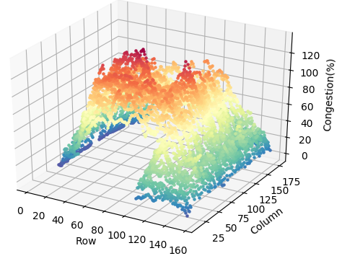
4. Model Training
Sample filtering: filter outliers and improve the quality of the dataset.
Unroll a loop with a large unrolling factor.
Multiple copies of the same operation.
These copies can be placed to distant locations.
Some are placed around the margin of FPGA.
Their congestion metrics deviate from most of the replicas (~3% outliers).
Distribution of the vertical routing congestion metrics for Face Detection on FPGA.

Slide 21
4. Model Training
Machine learning models: compare and select the best model for our problem.
Lasso linear model.
Linear relationships.
Tuning parameter: the constant α that multiplies the L1-norm.
Artificial neural network (ANN).
Several hidden layers between the input and output layers.
Tuning parameter: a number of hyperparameters.
Gradient boosted regression trees (GBRT)
Multiple weak prediction models are combined to form a powerful regression ensemble.
Tuning parameter: the number of estimators, the learning rate…

Slide 22
5. Congestion Prediction
Model training
Design
High Level Synthesis Flow
Features
Models
Congestion
Prediction
Modified Design
Congestion Resolving
Congested
Region
Optimized Design
Based on the trained model, the congested regions can be detected in the C/C++ source code.
Analyze the reasons of the routing congestion and find solutions.
Modify source code.
Change synthesis directives.
Recursively mitigate congestion and optimize the target application.
Case Study

Slide 23
Outline
Background
Machine-Learning Based Methodology
Experimental Results
Conclusion

Slide 24
Experiments
Benchmark suite: Rosetta.
Device: Xilinx FPGA xc7z020clg484.
Our dataset contains 8111 samples.
302 features in seven categories.
3 labels: vertical congestion metric, horizontal congestion metric and their average.
Tools: Vivado design suite 2018.1, Scikit-learn machine learning library.
The property of the benchmarks are shown in:
Congestion Metrics | WNS (ns) | Frequency (MHz) | Vertical Congestion (%) | Horizontal Congestion (%) | Avg. (V, H) Congestion (%)
Max | -3.253 | 75.5 | 133.33 | 178.96 | 144.87
Min | -13.643 | 42.3 | 5.06 | 8.90 | 6.73
Avg. | -8.386 | 54.4 | 60.58 | 72.47 | 64.89

Slide 25
Estimation Accuracy
Regression Models |  | Vertical Congestion (%) |  | Horizontal Congestion (%) |  | Avg. (V, H) Congestion (%)
 |  | MAE | MedAE | MAE | MedAE | MAE | MedAE
Not Filtering | Linear | 13.90 | 10.88 | 18.02 | 12.62 | 13.73 | 9.94
 | ANN | 12.19 | 7.91 | 17.68 | 12.62 | 12.27 | 8.17
 | GBRT | 10.55 | 7.37 | 15.71 | 10.89 | 10.57 | 6.78
Filtering | Linear | 12.41 | 9.20 | 17.48 | 12.16 | 12.76 | 9.50
 | ANN | 10.23 | 7.43 | 16.61 | 11.78 | 11.67 | 7.83
 | GBRT | 9.59 | 6.71 | 14.54 | 10.05 | 9.70 | 6.81
10-fold cross validation and grid search.
Mean absolute error (MAE) measures the average value of the absolute relative errors.
Median absolute error (MedAE) reflects the distribution of the absolute relative errors.
Best performance: the GBRT model.

Slide 26
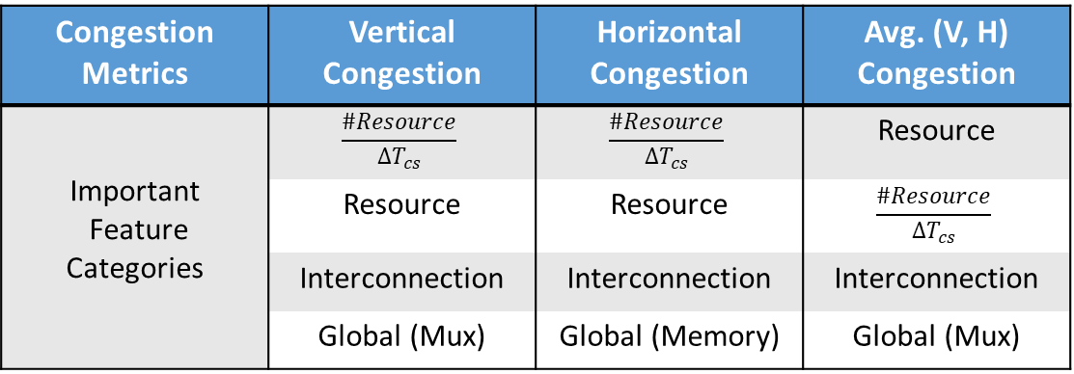
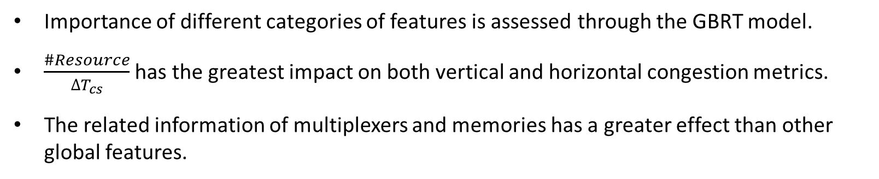
Important Features
Congestion Metrics | Vertical Congestion | Horizontal Congestion | Avg. (V, H) Congestion
Important Feature Categories | $$\frac{\#Resource}{∆T_{cs}}$$ | $$\frac{\#Resource}{∆T_{cs}}$$ | Resource
 | Resource | Resource | $$\frac{\#Resource}{∆T_{cs}}$$
 | Interconnection | Interconnection | Interconnection
 | Global (Mux) | Global (Memory) | Global (Mux)
Importance rank
Importance of different categories of features is assessed through the GBRT model.
$\frac{\#Resource}{∆T_{cs}}$ has the greatest impact on both vertical and horizontal congestion metrics.
The related information of multiplexers and memories has a greater effect than other global features.

Slide 27
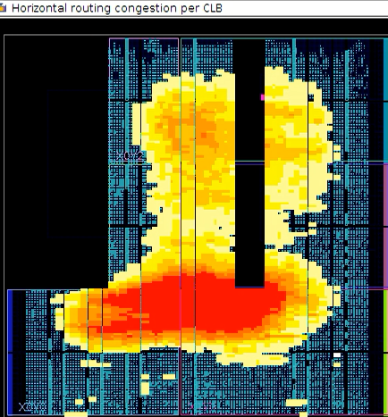
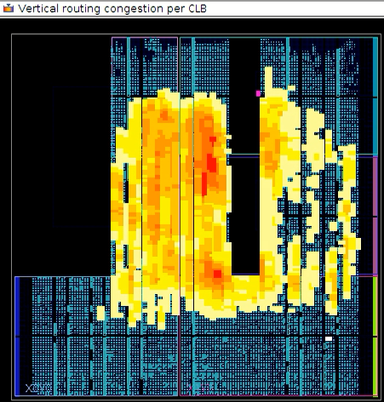
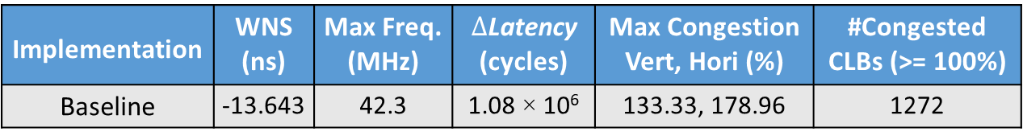
Case Study
Implementation | WNS (ns) | Max Freq. (MHz) | $∆$Latency (cycles) | Max Congestion Vert, Hori (%) | #Congested CLBs (>= 100%)
Baseline | -13.643 | 42.3 | 1.08 × 10⁶ | 133.33, 178.96 | 1272
Application: Face Detection
Baseline: Original design.
Severe routing congestion degrades the maximum frequency significantly.
Performance trade-off
Baseline(H)
Baseline(V)

Slide 28
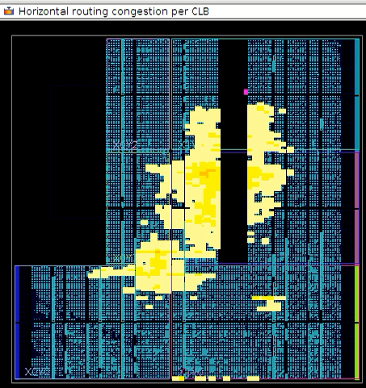
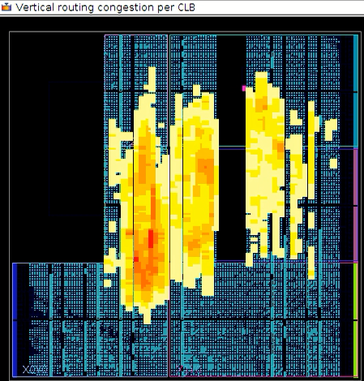
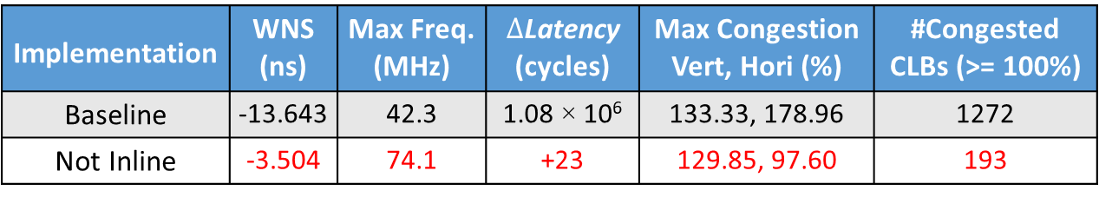
Case Study
Implementation | WNS (ns) | Max Freq. (MHz) | $∆$Latency (cycles) | Max Congestion Vert, Hori (%) | #Congested CLBs (>= 100%)
Baseline | -13.643 | 42.3 | 1.08 × 10⁶ | 133.33, 178.96 | 1272
Not Inline | -3.504 | 74.1 | +23 | 129.85, 97.60 | 193
Step 1: Not Inline
The classification function contains 52 classifiers.
Function inlining increases the complexity in C synthesis and generates a larger design.
Not inline the classifiers.
Step 1
Not Inline(H)
Baseline(H)
Step 1
Not Inline(V)
Baseline(V)

Slide 29
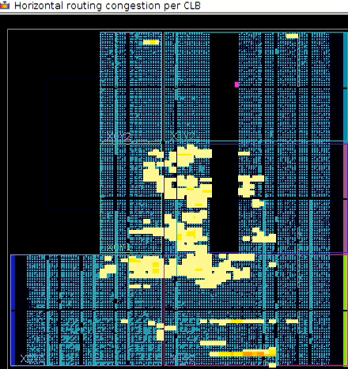
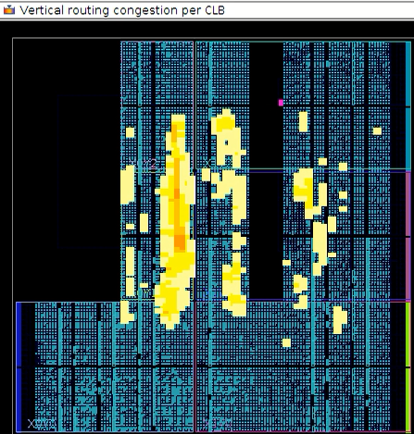
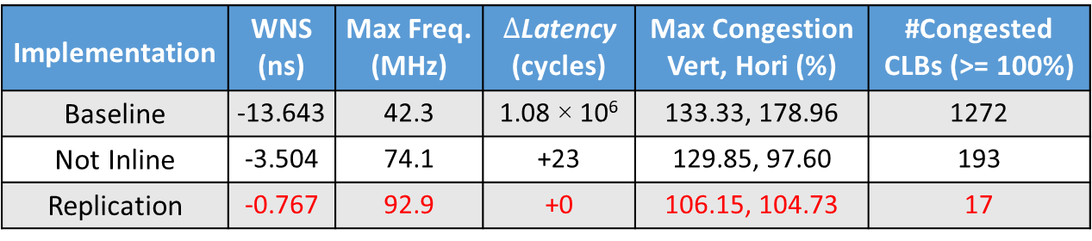
Case Study
Implementation | WNS (ns) | Max Freq. (MHz) | $∆$Latency (cycles) | Max Congestion Vert, Hori (%) | #Congested CLBs (>= 100%)
Baseline | -13.643 | 42.3 | 1.08 × 10⁶ | 133.33, 178.96 | 1272
Not Inline | -3.504 | 74.1 | +23 | 129.85, 97.60 | 193
Replication | -0.767 | 92.9 | +0 | 106.15, 104.73 | 17
Step 2: Replication
All the classifiers access the same completely partitioned array and multiple classifiers share the same inputs.
A large number of interconnections.
Modify the source code by replicating the values of the input data and sending copies to different classifiers.
Step 1
Not Inline(H)
Step 2
Replication(H)
Baseline(H)
Step 1
Not Inline(V)
Step 2
Replication(V)
Baseline(V)

Slide 30
Outline
Background
Machine-Learning Based Methodology
Experimental Results
Conclusion

Slide 31
Conclusion
We propose a novel machine-learning based methodology to predict routing congestion in FPGA HLS.
Experiments show that the GBRT model achieves the highest prediction accuracy.
Based on our model, routing congestion can be mitigated step by step and the performance of Face Detection can be improved significantly.

Slide 32
Thank you for listening!
Q & A

